Slide 1
Electricity – Part 2
Electric Potential Energy and Voltage

Slide 2
Static Electricity Review - INB
Static electricity is the build up of charge. What are the two types of charges?
Positive charges (lose e-) and negative charges (gain e-)
2. What did we discover that separates electric charges?
Friction → rubbing two materials against each other. Moving electrons.

Slide 3
Static Electricity Review
3. You have four different materials labelled A, B, X and Y. After you rub A and B together, they attract each other. After you rub X and Y together, they repel each other. Now you bring A near to X and observe that they attract each other. What would happen if you brought B near Y? Explain your reasoning.
Rub A (+) B(-) → attract
Rub X (-) Y (-) → repel
Bring Together A (+) X (-) → attract
Bring Together B (-) Y (-) → repel

Slide 4
Video – Can an apple charge a phone?

Slide 5
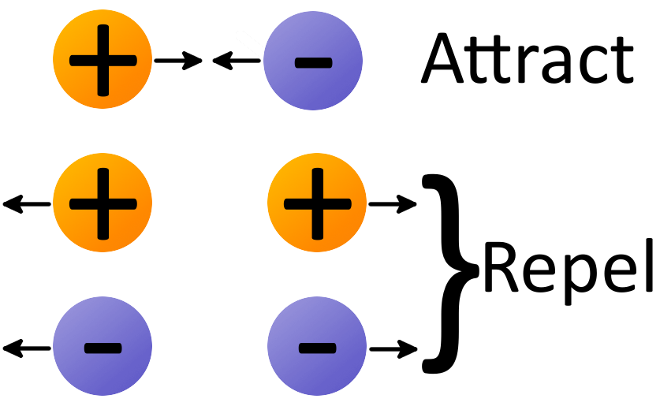
Electric Charge
Unlike charges want to come back together
→ opposite charges attract
Like charges want to move away from each other
→ Like charges repel

Slide 6
Energy and Work
Energy – is the ability to do work.
It doesn't mean work is being done, but that work can be done.
Example – a battery has the potential electrical energy to do work (i.e. make your cell phone work).
Work – is done on an object when a force acts on it and makes it move through some distance.
It is energy transfer. Work is a change in energy via a force.

Slide 7
Potential Energy & Kinetic Energy
Potential Energy – the energy stored in an object
Apple has potential energy due to gravity
As it falls converts potential energy into kinetic energy (motion)

Slide 8
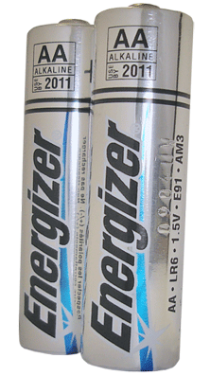
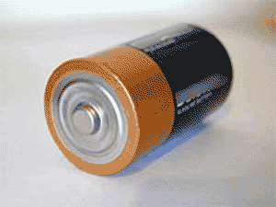
Electric Potential Energy
Electrochemical Cells – converts chemical energy into electrical energy stored in charges.
Battery – a combination of one or more electrochemical cells.

Slide 9
Electric Potential Energy
Electrons have stored energy and the ability to do work after they leave the battery.
Electrons separated from the positive nucleus “want” to return to their original location. If these electrons are held separated, then these electrons have electric potential energy.
The further we move unlike charges apart, the more electric potential energy they gain.
Electrons will help convert electrical energy into another type of energy (i.e. heat or light) when a circuit is complete.

Slide 10
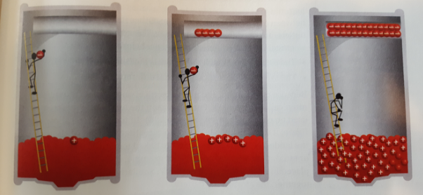
Model explaining how charges are separated and gain electric potential energy
A
B
C

Slide 11
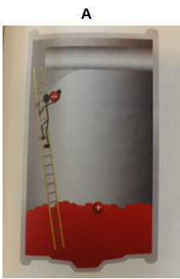
Separation of charge due to chemical reactions in a electrochemical cell
The worker easily carries the first electron up the ladder and places it at the negative terminal.
The worker leaves the (+) ion at the positive terminal.
The first electron is easy to carry because the attraction is not very strong. Only a small amount of electrical energy is stored in the cell.

Slide 12
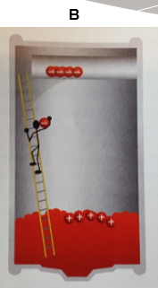
Separation of charge due to chemical reactions in a electrochemical cell
The (+) ions at the positive terminal are attracting the negative charge of the electron that the worker is carrying.
As well, the electrons at negative terminal are repelling the negative charge of the electron that the worker is carrying.
The worker (chemical E) has done a lot of work to separate charges.
This energy is now stored in the electric potential energy of the separated charges.

Slide 13
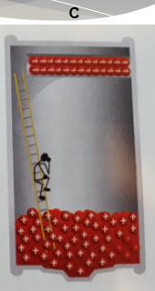
Separation of charge due to chemical reactions in a electrochemical cell
Eventually the repulsion of the electron by the negative charges and the attraction by the positive charges gets so strong that the worker cannot carry any more electrons up the ladder.
No more chemical energy will be transformed into electrical energy

Slide 14
Electric Potential Difference or Voltage
The Potential Difference is the change in the amount of electric potential energy per one coulomb of charge → called the voltage
Separation of charge (separation of electrons from nucleus) + the amount of charge separated (# of electrons moved)
Unit of Voltage – Volts (V)
Voltmeter – a device that measures the amount of potential difference between two locations of charge separation.

Slide 15
What is a Coulomb of Charge? Unit of Electric Charge -Coulomb
It takes the addition or removal of 6.25 x 10¹⁸electrons to produce 1 Coulomb (C) of charge.
NOTE: 6.25 x 10¹⁸ is equal to:
6250000000000000000

Slide 16
Why is it called a difference?
It is called a difference because it measures the difference in electrical potential energy per unit of charge between the positive terminal and the negative terminal in a cell.
To charge a cell, a chemical reaction does work to separate electrons and (+) ions and it takes more energy as more charge is moved
This is because the forces of attraction and repulsion acting on the electrons moving get stronger and stronger.

Slide 17
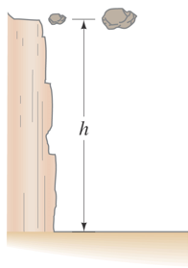
Gravity / Rock Analogy
Rocks off the ground have potential energy
The bigger rock has more potential energy (PE) because, PE = mgh
Where m = mass, g = gravity, h = height
Electric Potential Difference (Voltage)
1) The height of the rock is the potential difference (separation of charge)
2) The mass of the rock is amount of charge separated (how many electrons have been separated)
Think of a potential difference (voltage) as the height of an object
The amount of charge separated is like the mass of the object that has been lifted.

Slide 18
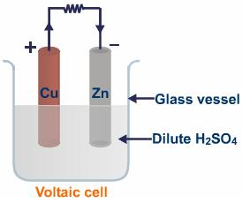
How Batteries Work
Batteries have two terminals called electrodes
two different types of metals that have a different affinity to either accept or lost electrons
These electrodes are in an electrolyte
a substance that conducts electricity – causes electrons to be either added or removed from the metals

Slide 19
How Batteries Work
There is now a separation of charge: one electrode is now (+) charged and one electrode is now (–) charged
This produces a potential difference (voltage) between the two electrodes.

Slide 20
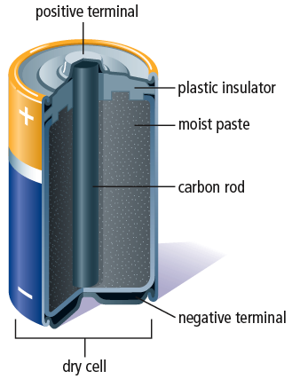
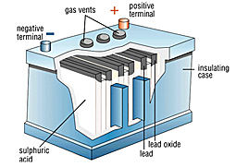
Classifications of Batteries
Dry cells are used in:
flashlights, MP3s, iPods, smartphones, watches, remote controls
Common disposable battery found in electronic devices
Wet cells are used in:
cars, motorcycles, electric motorcycles
Common battery found in automobiles and golf carts, that can be recharged as using

Slide 21
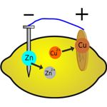
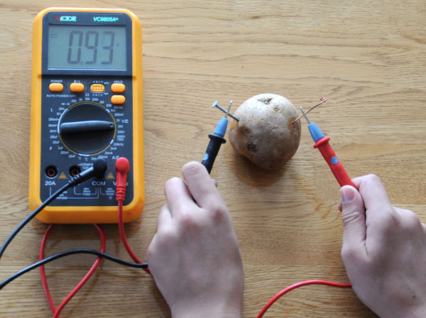
Can Fruits or Vegetables be Made into a Battery?
How to make a Lemon Battery

