Slide 1
CHAPTER 5
Asexual Reproduction Types
Section 5.2

Slide 2
Asexual Reproduction
Remember
Most of the time (~95%) the cell is in interphase (doing its job, growing, surviving, etc.).
When a cell gets too big (its volume outgrows its surface area), it must divide/reproduce.
Some animals have adopted a reproductive strategy that is as simple and efficient as that of a cell.
In order to reproduce they create an identical copy of themselves using the same process of mitosis that a single cells uses.

Slide 3

Asexual Reproduction
Asexual reproduction produces offspring that are an exact genetic copy of the parent
→ called a clone
→ offspring will have the exact same number of chromosomes as the parent cell
With cloning, only one individual required
→ does not require a partner or mate

Slide 4
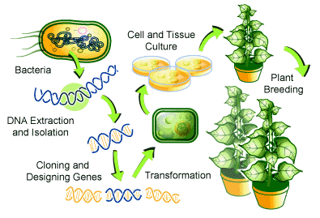
Asexual Reproduction
Cloning is also used in agriculture and research to copy desired organisms, tissues and genes
This is how the cells of multi-cellular organisms (like your body cells) reproduce and multiply

Slide 5
Asexual Reproduction
Asexual reproduction is common in many types of plants, single-celled organisms, as well as some multi-cellular organisms.
Types of Asexual Reproduction
  Binary fission
  Budding
  Fragmentation
  Vegetative reproduction
  Spore formation
Asexual Reproduction (3 min. video)

Slide 6
Binary Fission
A single cell (unicellular) splits into two identical copies
Only one strand of DNA to be copied.
Ex. Bacteria

Slide 7
Budding
Budding can occur in unicellular or multi-cellular organisms.
Buds grow (by mitosis) and develop into a new organism
Example. Hydra

Slide 8
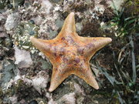
Fragmentation
Part of an organism breaks off due to injury
The part grows into a clone of the parent
Example. Starfish, milfoil

Slide 9
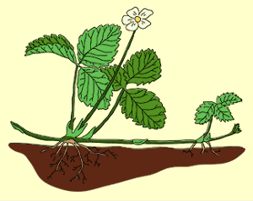
Vegetative Reproduction
Special cells in plants that develop into structures that form new plants identical to the parent
Example. Spider plants, grafting fruit trees, runners and rhizomes, tubers and bulbs

Slide 10
Spore Formation
Some bacteria, micro-organisms and fungi can form spores
Spores are single cells that can grow into a whole new organism
Ex. Penicillium

Slide 11
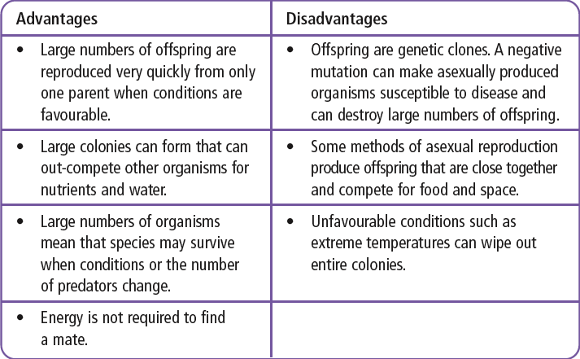
Why Asexual?
See Page 175

Slide 12
Human Assisted Cloning
Two types of cloning techniques
→ Reproductive and Therapeutic
Reproductive Cloning
Purpose is to produce a genetic duplicate of an existing or dead organism.
Steps involved (adult DNA cloning) :
  Remove nucleus from an egg cell
  Remove a mammary gland cell from an adult female
  Electricity fuses the mammary cell and egg cell
  Fused cell begins dividing
  Dividing embryo is inserted into surrogate mother
See Pages 176 - 177

Slide 13
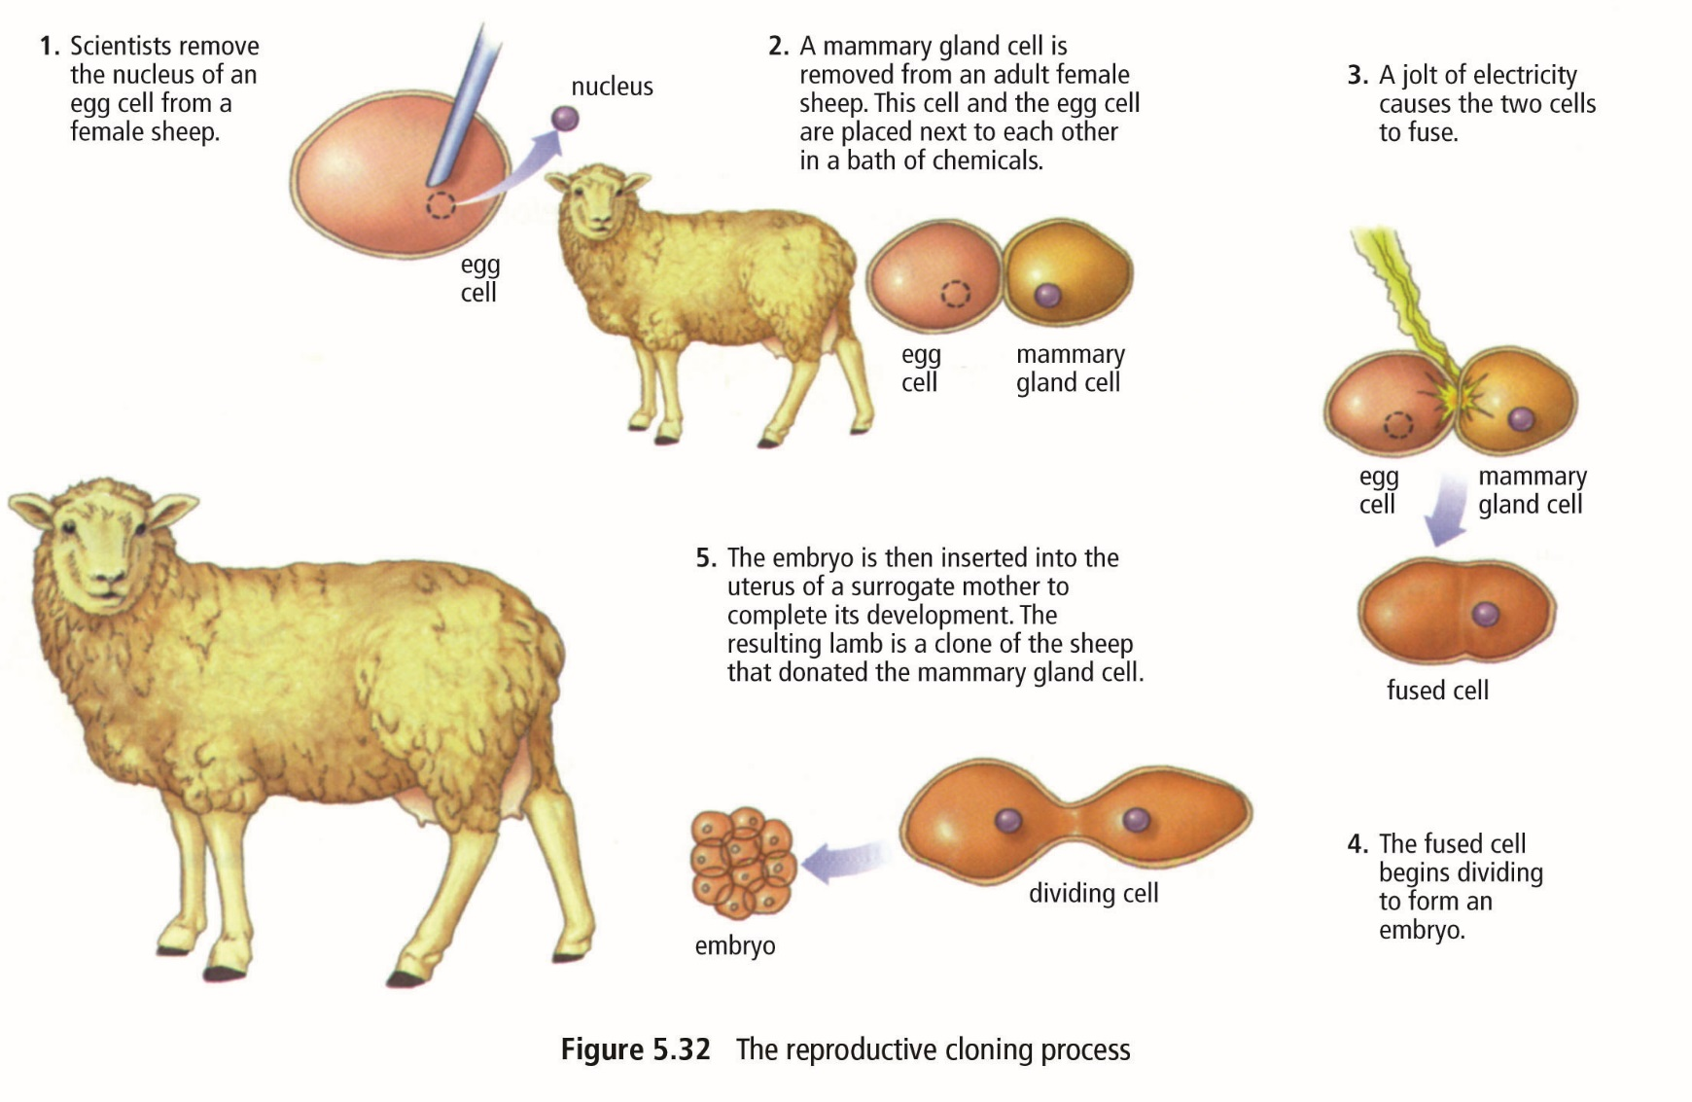
Reproductive Cloning

Slide 14
Therapeutic Cloning
Purpose is to correct health problems
  Stem cells
    Cells that can become different types of cells
    Can be used to replace cells
    damaged from injuries or disease
  Diabetes, spinal injuries, Parkinson’s
  disease are only a few that can
  benefit from stem cell therapy
  Controversial because the best
  stem cells are from embryos which
  are destroyed when harvesting cells
Cloning - debate
See pages 177 - 178

Slide 15
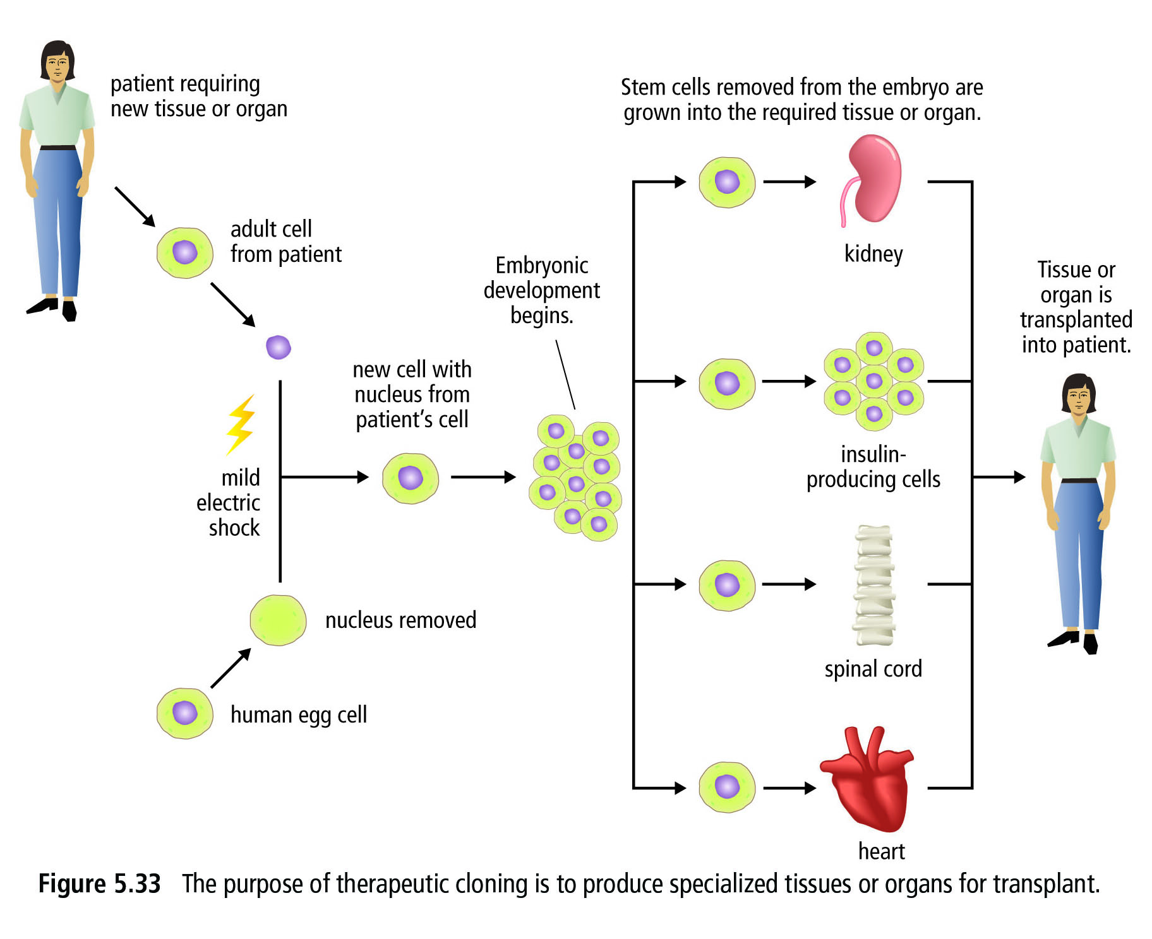
Therapeutic Cloning

Slide 16
Summary
Can you…
Explain what asexual reproduction is?
Explain the different methods of asexual reproduction?
What are some of the benefits of reproducing asexually?
What are some of the problems with reproducing asexually?
What is Reproductive Cloning?
What is Therapeutic Cloning?

