Slide 1
Physics
Static Charge is Produced by Electron Transfer

Slide 2
Static Charge
An excess of positive or negative charges that stay in place on an object for a relatively long period of time.
Examples: Lightning, static cling in clothes, receiving a shock when touching a door handle

Slide 3
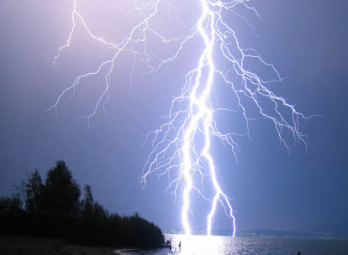
Lightning

Slide 4
Lightning

Slide 5
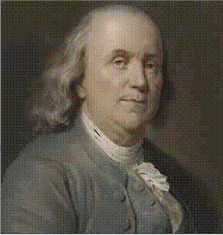
Positive and Negative Charges
Charles Du Fay (1698 – 1739) discovered two types of static electric charges. Benjamin Franklin (1706 – 1790) named the two charges positive (+) and negative (-) charges.

Slide 6
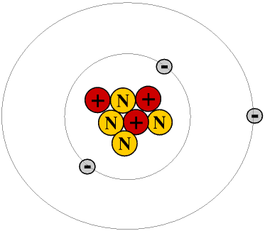
Lithium Atom
Why is this atom neutral?
Number of protons = # of electrons
When an atom loses electrons it becomes…
POSITIVE
When an atom gains electrons gains it becomes…
NEGATIVE

Slide 7
What Moves?
Electrons orbit the nucleus and MOVE QUITE EASILY.
Movement or transfer of electrons from one atom to another changes the charge on the atom.
One way to move electrons is by FRICTION!

Slide 8
Unit of Electric Charge -Coulomb
It takes the addition or removal of
6.25 x 10¹⁸ electrons to produce 1 Coulomb
(C) of charge.
NOTE: 6.25 x 10¹⁸ is equal to:
6250000000000000000

Slide 9
Electric Force
Force – a push or a pull
Electric Force – a push or pull between charged objects
Contact Forces – a force when objects are touching
Action-at-a distance Forces – a force can be applied without objects touching.

Slide 10
Laws of Static Electricity
Opposite charges attract.
Like charges repel.
Neutral objects are attracted to charged objects.

Slide 11
Electric Force and Electric Charge
The electric force that a particle exerts on another particle is directly proportional to the product of their electric charges.
What does directly proportional mean?
as one amount increases, another amount increases at the same rate.
What does indirectly proportional mean?
when one value decreases at the same rate that the other increases.

Slide 12
What does this mean for electric charge and electric force?
If there is an increase of charge on an object, then the electric force between two objects will…
INCREASE
If there is an increase in distance between two charged objects, then the electric force will…
DECREASE

