Slide 1
Physics Unit - Part 2
Electric Current

Slide 2
Electric Current
Brainiac – Electric Fence
Electric Circuit – a complete pathway that allows electrons to flow.
Conductor – any material that electrical charges can move through
Example – metals
Conductivity – an indication of how easily charges travel through a material.
Insulator – A material through which charges cannot travel at all.
Examples – rubber, plastic, wood, glass, most non-metals

Slide 3
Circuits
What are the basic parts of a circuit?
Circuits are made up of four basic parts:
Source – source of electrical energy.
Conductor – the wire that electric current flows.
Load – a device that transforms electrical energy into other forms of energy. (Examples: bulb, buzzer, heater, motor)
Switch – a device that can turn the circuit on or off by opening/closing the circuit.

Slide 4
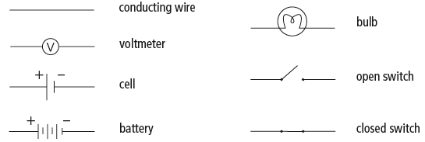
Circuit/Schematic Symbols
Use symbols to represent different components in a circuit.

Slide 5
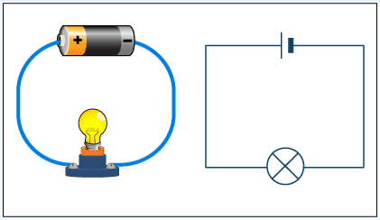
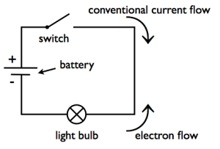
Simple Circuit Diagrams

Slide 6
Electric Current
Electric Current – flow of charged particles (electrons) in a complete circuit.
Is defined as one coulomb of charge passing a given point per second.
The flow of electrons from the negative terminal to the positive terminal through a wire
Unit of Current – amperes (A)
Ammeter – used to measure the electric current flowing in wires.

Slide 7
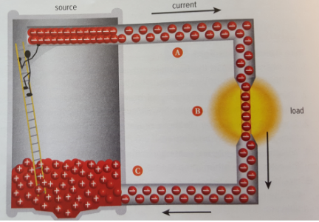
Model of Current Flowing through Circuit
At (A) - Electrons are attracted to the positive charges and are repelled by each other; so get pushed along the wire.
At (B) - Electrons pass through load and transfer some of their energy to load. Leave load and return to the cell
At (C) – Electrons enter cell and combine with (+) ions to become neutral. The worker than can carry more electrons up, keeping separation of charges equal.

Slide 8
Conventional Current
The flow of electricity is from negative to positive (the flow of electrons)
In the early days of electricity research, scientists mistakenly believed electricity flowed from positive to negative.
Descriptions of this flow from positive to negative still exists today, and is known as conventional current.
Video – Crash Course – Electric Current

