Slide 1
Electricity Unit – Part 2
Circuits are Designed to Control the Transfer of Electrical Energy

Slide 2
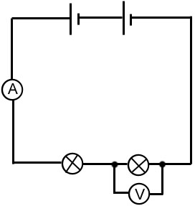
Series and Parallel Circuits
Series Circuits
Only one pathway for electrons to travel.
Total voltage = sum of voltages of all cells.
Current is the same in each part of the circuit.
Increase resistors/loads, the total resistance of the circuit increases.

Slide 3
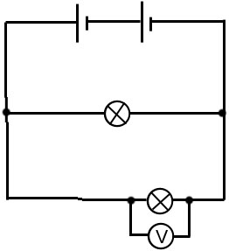
Series and Parallel Circuits Continued…
Parallel Circuits
There is more than one pathway or branch for electrons to flow.
Voltage is the same.
Current depends on which path/branch the electron takes and how much resistance there is in that pathway/branch.
Increase resistors/loads in parallel, the total resistance decreases.

Slide 4
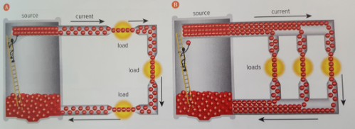

Slide 5
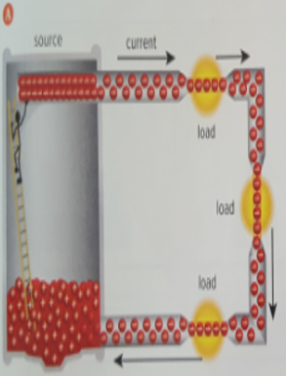
Series Circuit Model
Voltage total comes from cell
Add voltages from each load.
Current same anywhere in circuit.
As add more loads/resistors:
CURRENT decreases
RESISTANCE increases

Slide 6
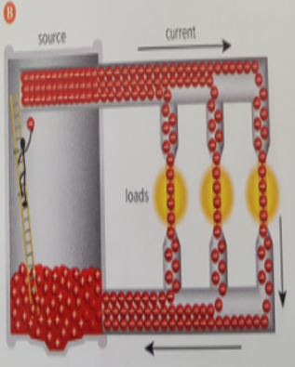
Parallel Circuit Model
Voltage same in the circuit
Current splits into different pathways/branches. In each path, the current is reduced, but I_{T} is sum of split current.
As add more loads/resistors:
CURRENT increases
RESISTANCE decreases

Slide 7
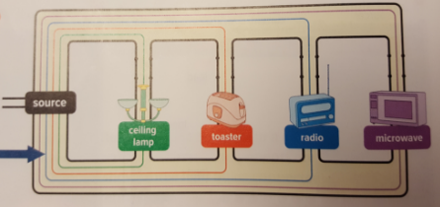
Series Circuits/Loads - Considerations
Why is it impractical to wire a home/school/building with a circuit in which all loads are connected in series?
If one load in a series circuit burns out, the circuit will be open, the charges will stop moving, and no loads in that circuit will work.

Slide 8
Parallel Circuit Loads - Considerations
Why are devices in one room connected in parallel?
Each can be controlled by its own switch without shutting off the others.
Provide a room in your house that has objects connected in parallel.

Slide 9
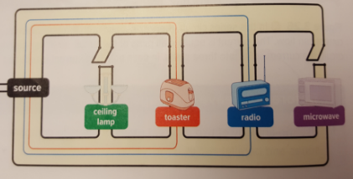
All switches are on; therefore all appliances working
Some switches off; therefore, some appliances working and some off.

Slide 10
Parallel Circuit Loads - Considerations
Should all electrical devices in an entire home be connected to the same parallel circuit? Safety considerations?
The current flowing to each device also would be flowing through the wire conductors connected to the source. This large amount of current would make wires extremely hot, possibly causing a fire.

Slide 11
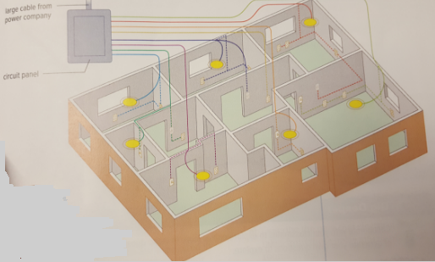
Parallel Circuit Loads - Considerations
Many separate parallel circuits are installed in buildings.

