Slide 1
CHAPTER 5
The Cell Cycle and Mitosis

Slide 2
Questions to consider…
What is reproduction?
What is the purpose of reproduction?
How are these three terms related: reproduction, sustainability, continuity?
What does the word continuity mean in terms of reproduction?

Slide 3
What is Reproduction?
The production of offspring by asexual or sexual processes.
What is the purpose of reproduction?
The transfer of genetic information from parents to offspring.

Slide 4
Asexual vs. Sexual Reproduction
Asexual Reproduction
Offspring come from a single parent
Offspring receive a copy of parent’s genetic material and are genetically identical to parent and each other
Sexual Reproduction
Offspring come from two parents
Offspring receive half their genetic material from one parent and half from the other; therefore are NOT genetically identical to parents or other offspring.
Parent Cell
Offspring
(daughter cells)
Parent Cells
Offspring
(daughter cell)

Slide 5
How are the terms reproduction, sustainability, and continuity related?
Sustainability refers to the ability of the environment and living things it supports to endure into the future.
Reproduction ensures that organisms have a source of nutrients and energy to sustain their life processes.
Continuity is how each species (kind) of organism continues to exist over time, from generation to generation.
Species continue to exist into the future only if its members reproduce.

Slide 6
Review for Science 8
Cell Theory:
All living organisms are composed of one or more cells.
The cell is the basic unit of life
All cells arise from pre-existing cells.

Slide 7
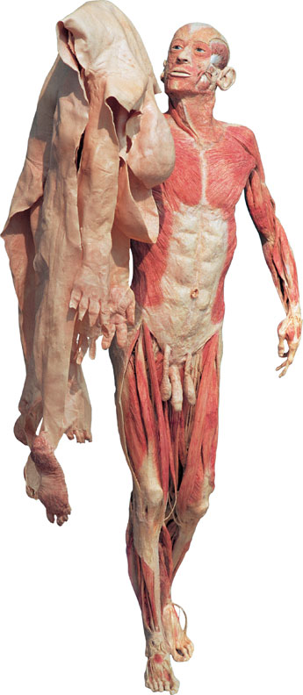
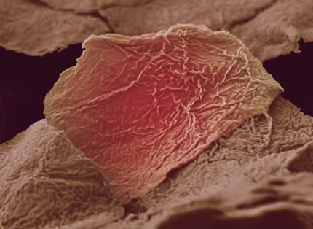
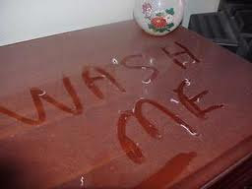
You shed millions of skin cells per hour
By one month you have completely replace the outer layer of your skin
The dust that settles on your furniture is a grey color,
70% is tiny flakes of mostly human skin.

Slide 8
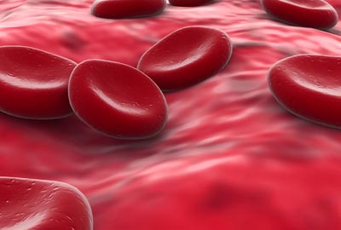
Every minute the body produces ~300 million new cells
The body has approximately 50-100 million trillion cells
Predict which cells in our body reproduce more frequently & why.
Red blood cells Stomach Lining cells
Liver cells Intestinal Lining cells
Brain cells Skin cells
120 days
2 days
200 days
3 days
30- 50 years
20 days
20-30 trillion RBC in the body

Slide 9
The Cell Cycle
All living things have a life cycle
→ from birth to death
All living things are made up of cells
→ cells must have life cycles too!
Due to the loss and death of cells
→ must replace them

Slide 10
The Cell Cycle
Two stages in the cell cycle:
1.Growth and Development: Interphase
Cell carries out normal functions and grows.
Replicates DNA and other organelles (preparation for the splitting of the cell)
2.Division stage: Mitosis and Ctyokinesis
a) Mitosis:
Nucleus contents duplicated and divided into two equal parts.
b) Cytokinesis:
Separation of two nuclei and cell contents into two daughter cells.
See pages 150 - 153

Slide 11
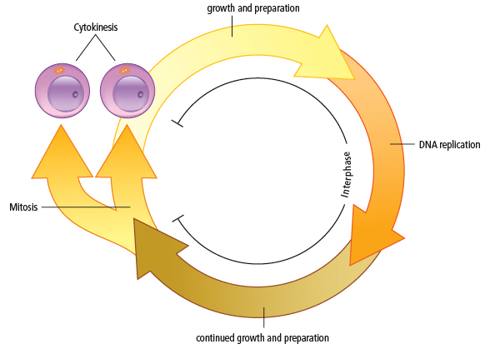
Parts of the Cell Cycle
2
1

Slide 12
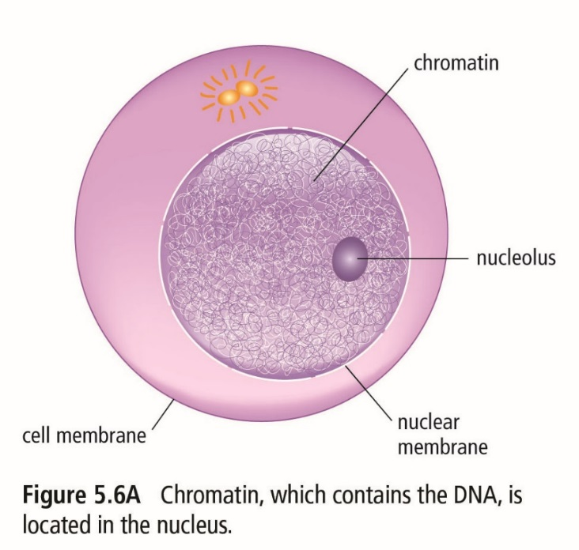
1. Interphase
The longest cell cycle stage (lasts 15 hrs. to months).
When the cell performs normal functions and grows.
Chromatin is loosely coiled so that DNA can be copied into RNA for proteins to be made in preparation for cell division.
The cell continues to grow and make proteins in preparation for mitosis and cytokinesis.

Slide 13
In late interphase, DNA copies itself in the process of DNA replication.
DNA Replication (video) involves several steps:
The DNA molecule unwinds with the help of an enzyme.
New bases pair with the bases on the original DNA.
Two new identical DNA molecules are produced.
→ This doubles the amount of DNA in nucleus
→ The cell can now divide (Mitosis + cytokinesis)

Slide 14
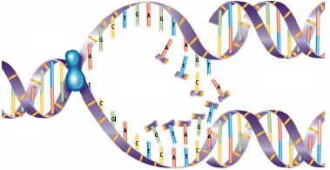
DNA Unraveling (Flash animation)
Interphase

Slide 15
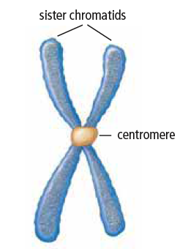
Chromosomes
Late Interphase/Prophase
As the nucleus prepares to divide the newly replicated DNA coils up and joins together to form two sister chromatids
The two identical chromatids are joined together by a centromere
→creating a chromosome

Slide 16
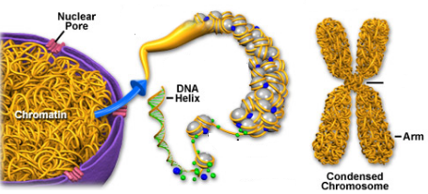
Connection Between DNA, Chromatin, and Chromosomes
DNA/Proteins (double helix) → chromatin (loosely coiled) → chromosomes (tightly coiled and replicated DNA)
Chromosomes
(tightly coiled)
Chromatin
(loosely coiled)
DNA/Proteins
(double helix)

Slide 17
Mitosis video
2a) Mitosis
Mitosis is the shortest stage of the cell cycle where the nuclear contents divide, and two daughter nuclei are formed.
It occurs in 4 stages:
Prophase
Metaphase
Anaphase
Telophase
Helpful saying to remember the order:
“I picked many apples today”

Slide 18
Mitosis - Prophase
Chromosomes start to coil and become visible.
Pairs of centrioles start to separate.
The nuclear membrane disappears.
Spindle fibers start to form between the centriole pairs.
Chromosomes move more evenly throughout the nucleus.

Slide 19
Mitosis - Metaphase
Centriole pairs move to opposite ends of the cell.
Spindle fibers are still attached to the centriole pairs.
Chromosomes line up along the midline of the cell and are attached to the spindle fibers.

Slide 20
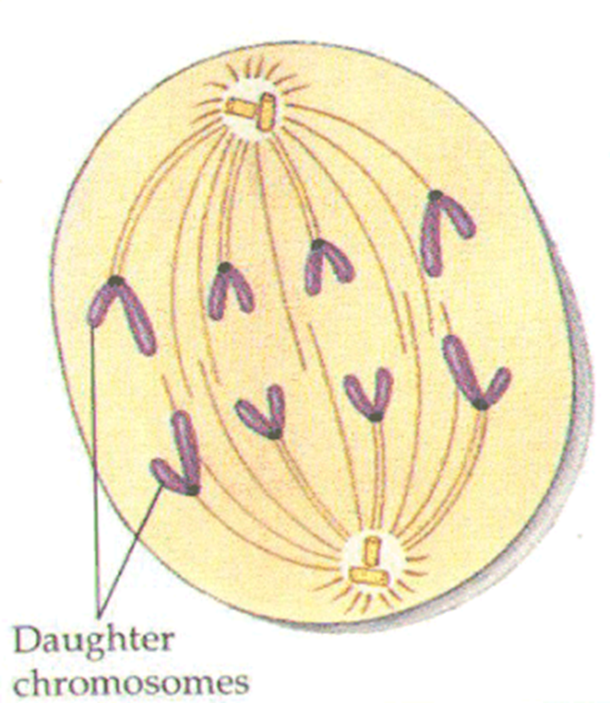
Mitosis - Anaphase
The pair of chromatids split at the centromere and move to opposite ends of the spindle.
Now there are twice the number of (single) chromosomes within the cell membrane.
The chromosomes move towards the opposite ends of the cell membrane aided by the spindle fibers.

Slide 21
Mitosis - Telophase
Nuclear membranes form around the two new sets of chromosomes.
The spindle fiber disappears.
Chromosomes start to uncoil (chromatin) and become less visible.
Cell starts to make a groove (furrow) in the middle to eventually split into two identical cells.

Slide 22
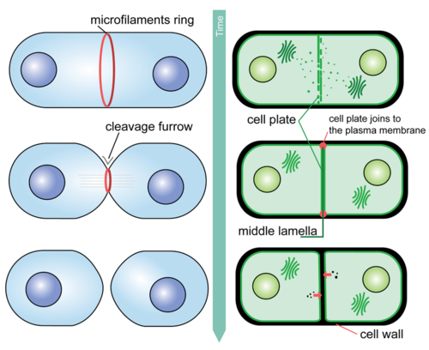
2b) Cytokinesis
The division of material outside of the nucleus.
Occurs at the end of telophase.
Cytokinesis divides the organelles and other substances in the cytoplasm into roughly two equal halves.
Animal cells furrow (pinch together) while plant cells form a cell plate that grows across between the two cells
Notes:
What if it wasn’t divided equally?
DNA is the blueprint to make everything in the cell
However, ribosomes must be in each new cell

Slide 23
At the end of cytokinesis…
# of chromosomes in daughter cell equals the # of chromosomes in the original parent cell.
Daughter cells are genetically identical to parent.
46
46
Parent Cell
46
Offspring

Slide 24
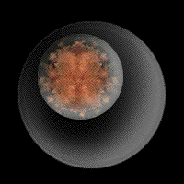
Cell Cycle Problems
There are special checkpoints in the cell cycle that will prevent cell division.
These checkpoints function as a fail safe so that only normal cells will survive to divide.
The cell will not divide if:
If the cell is short of nutrients
If the DNA within the nucleus has not been replicated
If the DNA is damaged

Slide 25
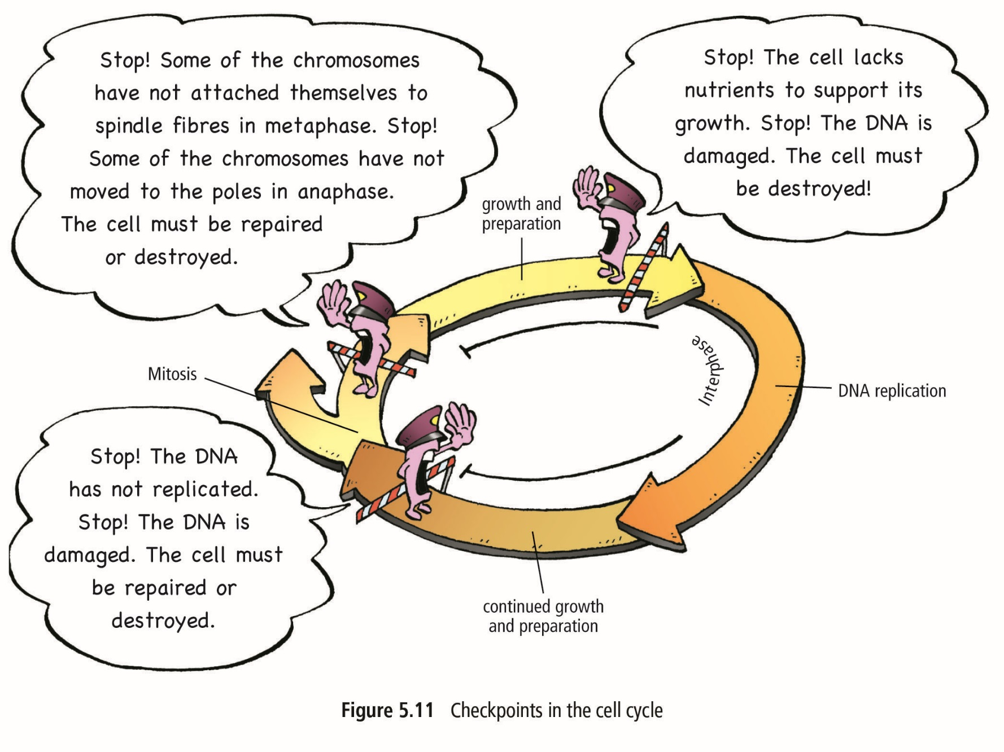
Cell Cycle Problems
Cell Cycle and Cancer Video

Slide 26
Cell Cycle Problems
Sometimes, gene mutations involving the checkpoints can result in an out-of-control cell cycle.
The result can be uncontrolled cell division called Cancer (12 slides of Flash animation)
Cancer cells have large, abnormal nuclei
Cancer cells are not specialized, so they serve no useful function
Cancer cells attract blood vessels and grow into tumours.
Cells from tumours can break away to other areas of the body (metastasis)
See pages 159 - 161

Slide 27
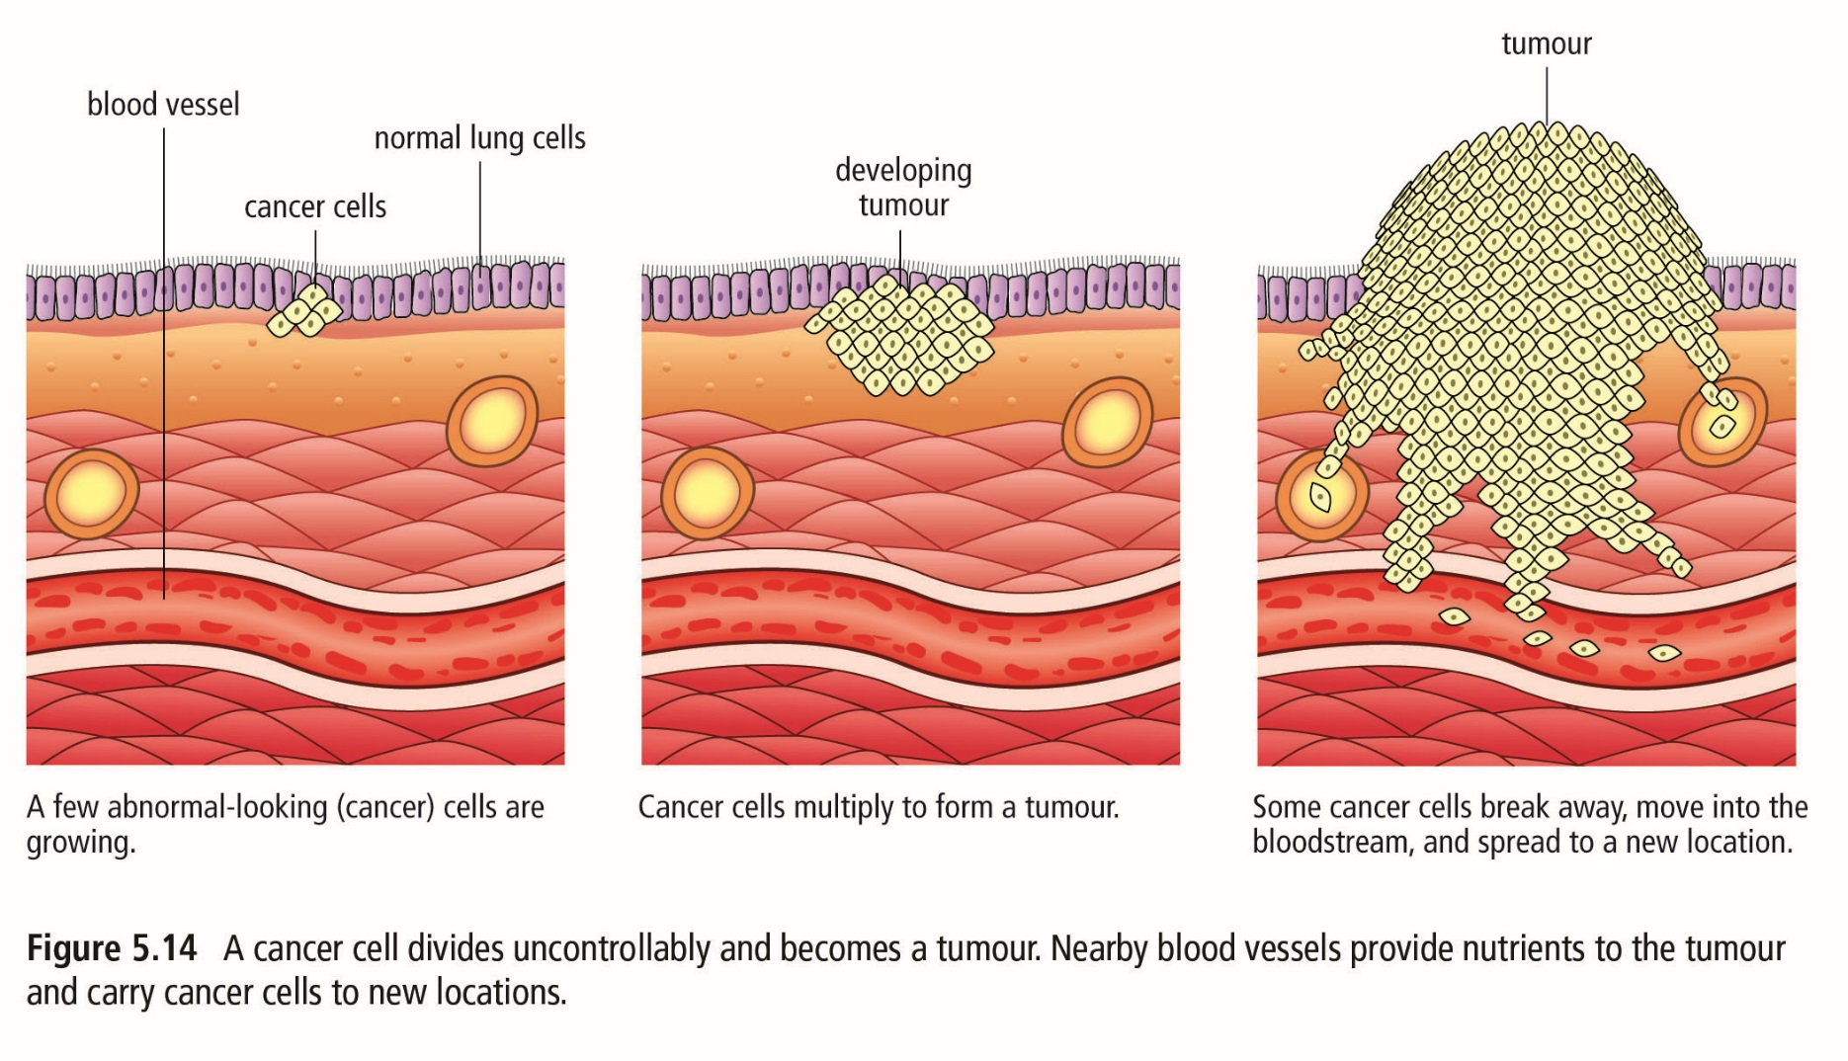
Cancer

Slide 28
Summary
Can you…
State why cells constantly need to be replaced?
Explain the 3 stages of the cell cycle?
Explain the 4 phases of mitosis
Explain what must happen during interphase if the cell wants to divide?
Describe why does the cell cycle have checkpoints?
Explain what Cancer is?

